Slide 1
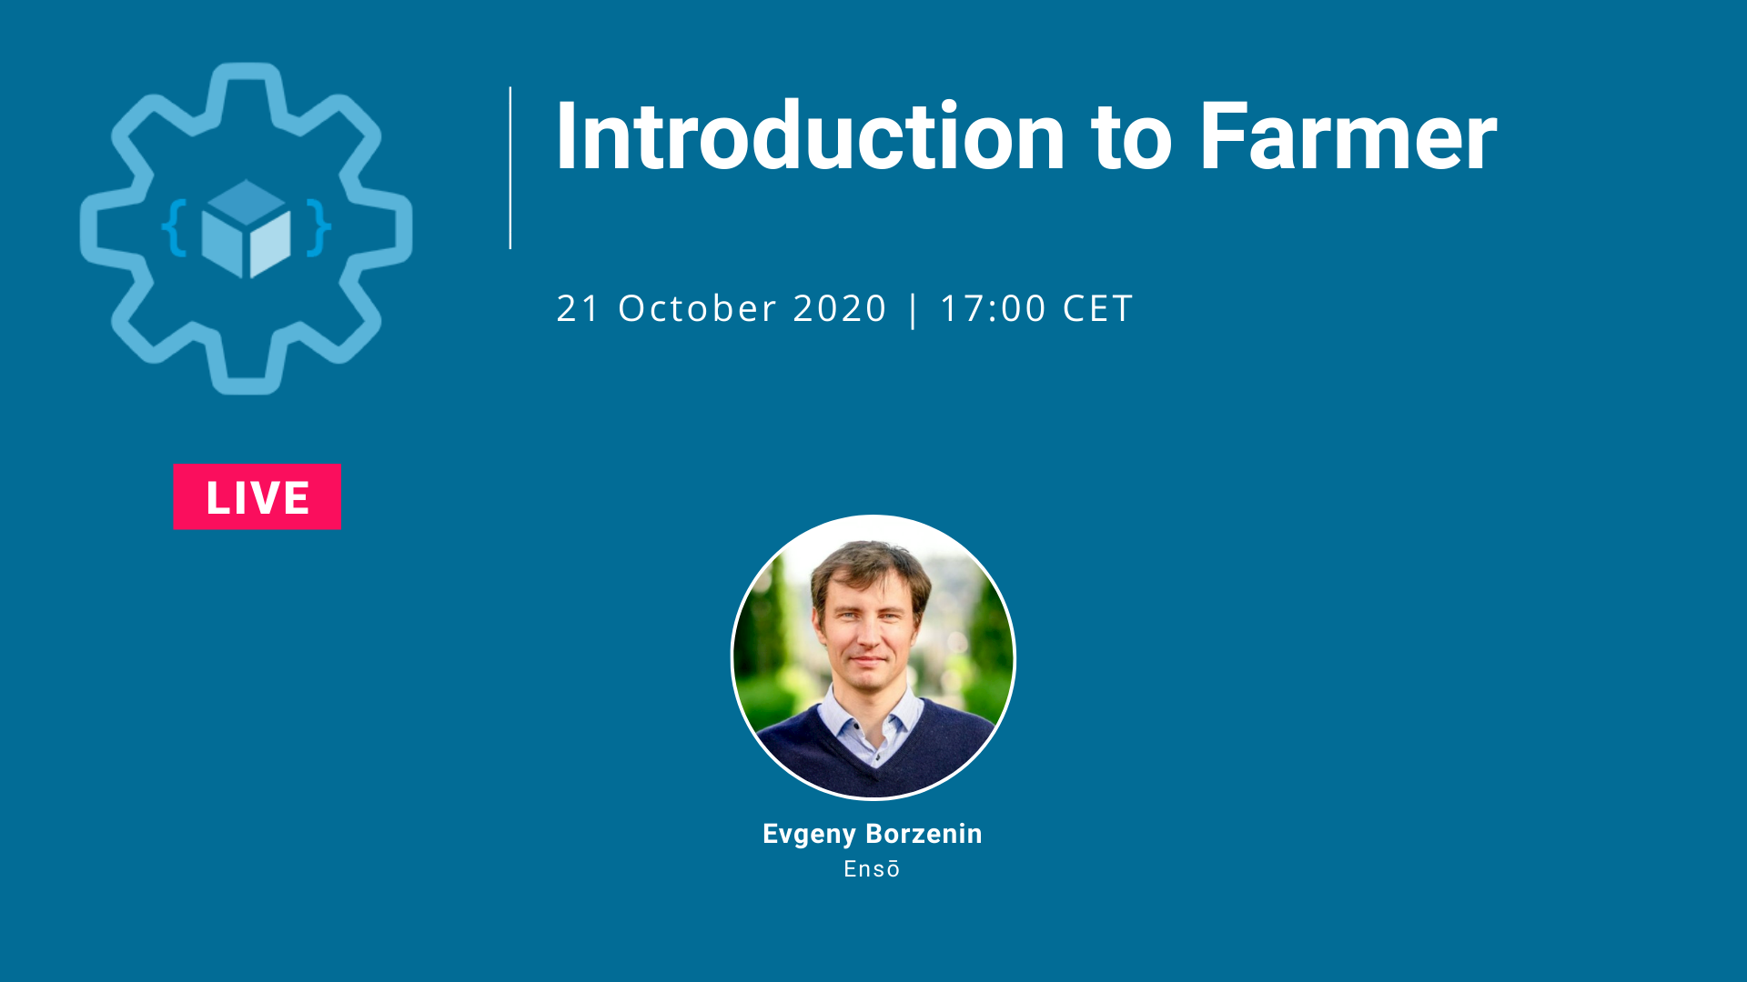

Slide 2


About me
Consultant at Konsulentselskapet Ensō AS
Developer and Architect with 20++ years of experience
Last 6++ years focus on Infra on Azure
Azure MVP
Infrastructure as Code User Group Oslo
Board member of NNUG User Group
Love automation

Slide 3

What is Infrastructure as Code?

Slide 4
Why Infrastructure as Code?

Slide 5


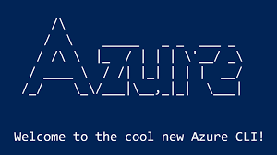
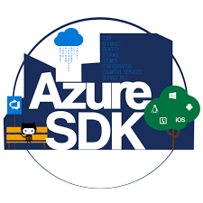


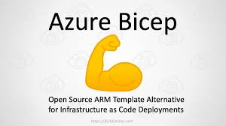

IaC on Azure

Slide 6
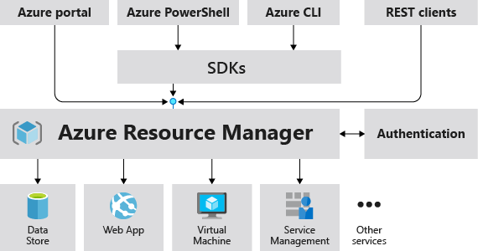
Unified Management API

Slide 7

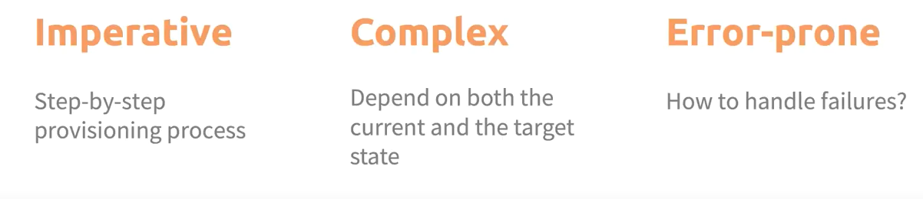
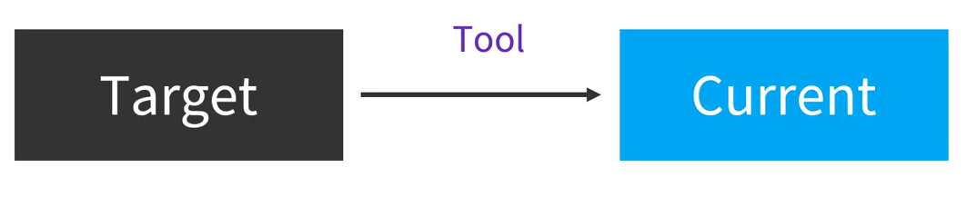
IaC on Azure
SDK and scripting
Desired state configuration (declarative)

Slide 8
IaC story at Vipps
ARM
az cli,
bash
ARM rest API with python
ARM
az cli, bash
Generate ARM with F#, C#, Python
ARM
az cli, bash
Terraform
Pulumi

Slide 9
What’s wrong with ARM templates?
Authoring
Lack of programming concepts like if-then, loops etc…
Json

Slide 10
ARM DSL tools
Home grown tools
F#, C#, Python

Slide 11
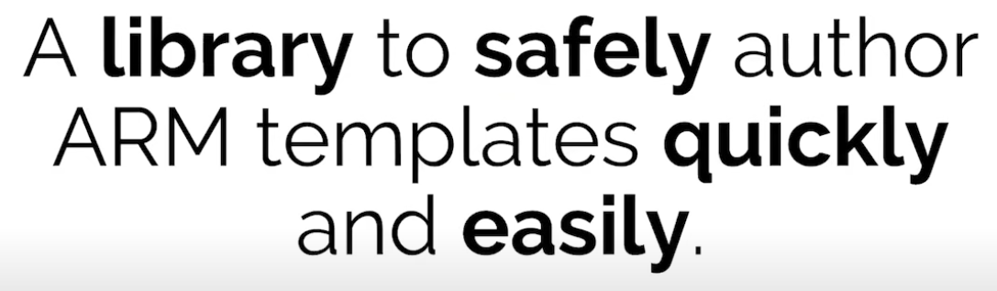
Farmer introduction

Slide 12
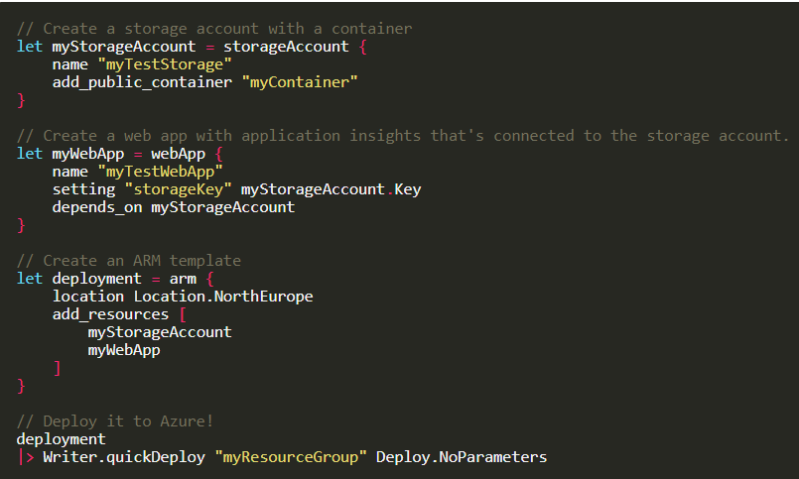
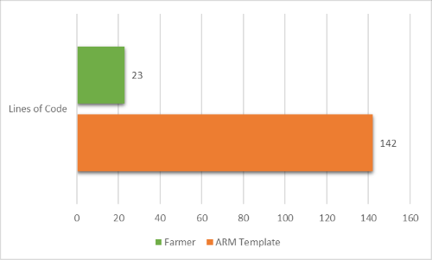
Farmer
ARM DSL tool (F#) to author and deploy ARM templates

Slide 13
Demo

Slide 14
Farmer architecture
Builders
Function
ARM
resources
Storage Account
Function
Server
Farm
Application
Insight
In-memory
resources
Resources
Secure
parameters
Outputs
Emit
Generate
ARM templates
Deploy to Azure

Slide 15
Deployment strategy
I don’t care about ARM template, just deploy!
I already have deployment strategy for ARM templates
CI/CD tools
Code
Build
CI
Azure
CI/CD tools
Code
Build
CI
Release
CD
Azure
ARM

Slide 16
Demo

Slide 17


